Slide 1
The Mental Capacity Act & Deprivation of Liberty Safeguards:
An Introduction
Phil Carter
(Mental Capacity Act / Deprivation of Liberty Safeguards, Training & Development Worker)
2018
Notes:
Flip Chart
Principles MCA

Slide 2

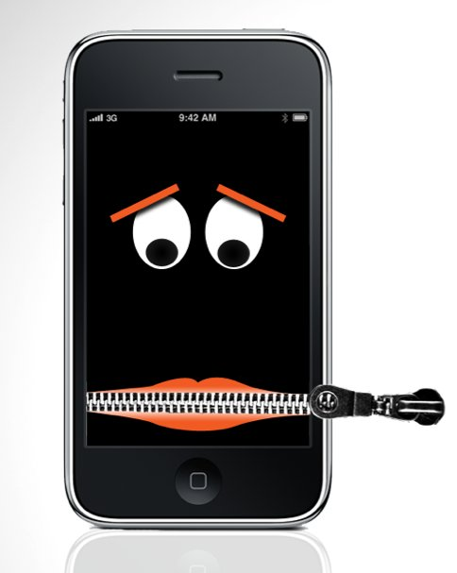

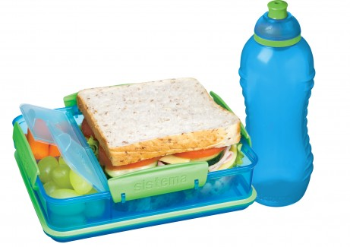



Slide 3
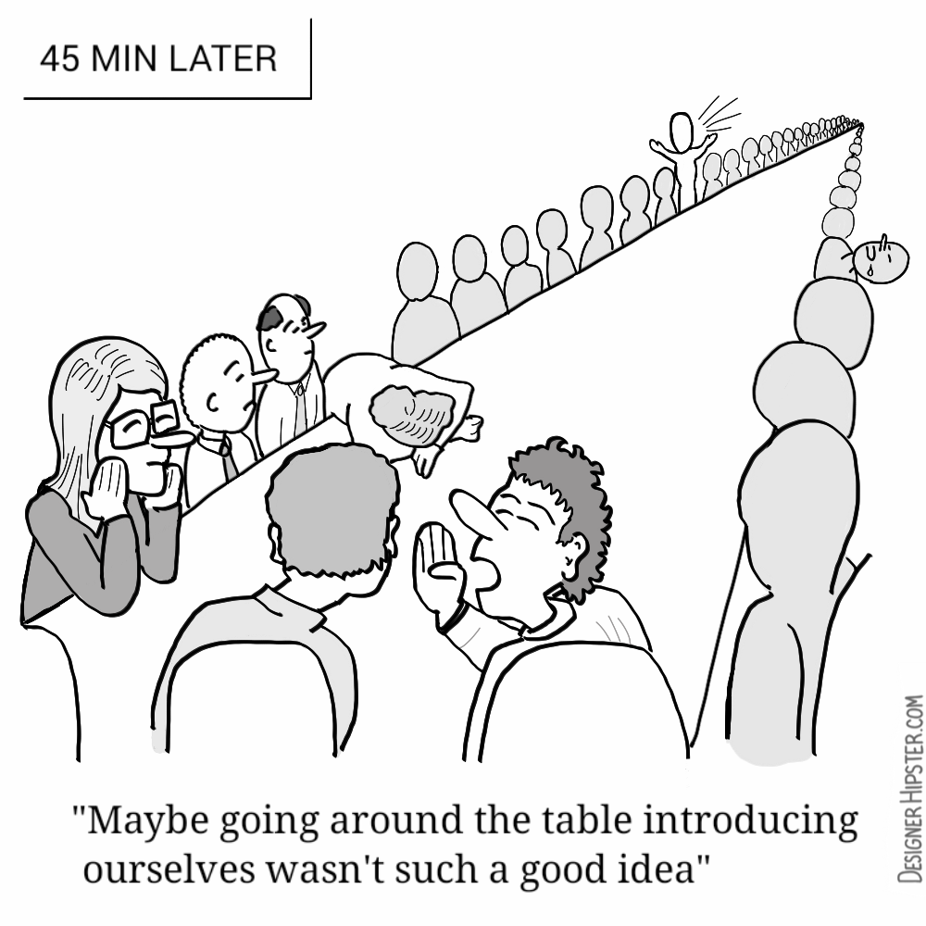
Introductions
Name
Job Role
Any questions?
Notes:
Give Your Background
Before we get started, I would like to get to know 3 things; Your Name, how long you have worked in your current job, when was the last time you had safeguarding training.

Slide 4
Mental Capacity Act
Human Rights
Consent to care and treatment
Assessing Capacity (Supported Decision Making)
Best Interest Decision Making
Restraints & Restrictions
Deprivation of Liberty
Today’s topics
For discussion:
Notes:
These are the main topics we will talk about today.
READ SLIDE
This is only an awareness course so today as I will explain is an opportunity to understand the core principles of the MCA. If you would like more practical knowledge of the MCA look to the back of your books for the other courses we offer.

Slide 5

Human Rights
Question:
Which human right,
gives you the right
to make your own
choices (aka:the
right to autonomy)?

Slide 6

Human Rights (pg.4)
The ECHR protects your essential rights, including the
rights to:
Article 1 : Obligation to respect human rights
Article 2: Right to life
Article 3: Prohibition of torture
Article 4: Prohibition of slavery and forced labour
Article 5: Right to liberty and security
Article 6: Right to a fair trial
Article 7: No punishment without law
Article 8: Right to respect for private and family life
Article 9: Freedom of thought, conscience and religion
Article 10: Freedom of expression
Article 11: Freedom of assembly and association
Article 12: Right to marry
In essence we have the right to self-determination, the right to choose our own path.
All staff are there to promote and uphold the Human Rights of the people we support.

Slide 7

Consent
When do you require consent from the people you support?
What support do you need to provide if consent is going to be valid?

Slide 8
Consent : Role of Professionals (Pg. 5)
To give valid consent or permission the person needs to have:
Information about the decision
Free choice to make the decision without being unreasonably pressured or forced
The Mental Capacity to be able to consent or refuse
To help someone to decide whether or not to consent we MUST EXPLAIN:
why the care or treatment is needed
the options available and what they entail.
what is likely to happen if the person does consent
what is likely to happen if the person refuses the care or treatment
We need to support the person on all occasions when their consent is required.

Slide 9

Consent
Imagine I was a new resident accessing your service (I arrived in the service yesterday), how would you support me to get up in the morning?
I need support with all daily tasks (I am also doubly incontinent), I have limited mobility and use a k-walker
I also have a diagnosis of Alzheimers

Slide 10
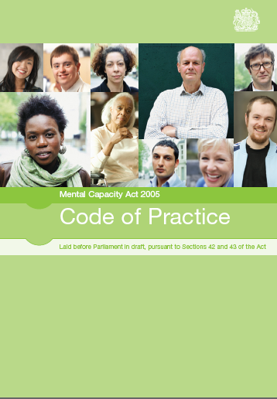
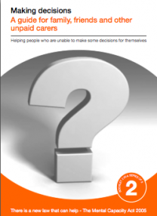
The Mental Capacity Act 2005 (pg.6)
Code of Practice
Anyone acting in professional role
Anyone with legal authority to make decisions on behalf of person lacking capacity
Anyone paid for acts in relation to a person who lacks capacity.
Guide for family carers
Notes:
SHOW BOOKLET
It is important that anyone working in a professional role, anyone with legal authority to make decisions on behalf of a person lacking capacity and anyone paid for supporting someone who lacks capacity has a copy of the Code of Practice in their work place.
It is important to look through this and highlight the key areas that affect the type of work you undertake, so they can be easily accessible if you ever have any queries.
Link on our website
A good suggestion would be to colour code and label the key pages, so people can access them when necessary.

Slide 11

Introducing the MCA
We should presume that adults have the capacity to consent to or refuse unless it can be established that they lack that capacity.
Each assessment of an individual’s capacity should relate to a specific decision
The Mental Capacity Act Code of Practice stipulates that professionals should never express an opinion on a person’s lack of capacity without carrying out a proper examination and assessment;
MPS: Consent to Medical Treatment in the UK

Slide 12
Exercise: What are the 5 Principles of the MCA in the correct order?
Mental Capacity Act
To Understand The Mental Capacity Act You Need to understand the
5 principles
?
?
?
?
?

Slide 13
MCA : 5 Principles
1
Presume Capacity
2
Practicable support
3
Unwise decisions
4
Best interests
5
Less
restrictive
Capacity
---------------
Lack Capacity

Slide 14
Mental Capacity Act
Principle 1
“A person must be assumed to have capacity unless established that she/he lacks capacity”
Incapacity cannot be simply based on:
  Appearance/ age/ gender/ condition/ diagnosis/ behaviour/ race…
  Incapacity to make other decisions
  An unwise decision
  Indecision
Notes:
Read Slide
Norwich Hospital Example drinking De-Icer
Kerry Wolliton

Slide 15
Mental Capacity Act
Look at these statements: what do you think about them in relation to the first principle:
  “All people with a learning disability lack capacity to make any decisions”
  “No one with dementia can look after any money”
  “This lady lacks all capacity to do anything whatsoever” (this is a real note written by a doctor in the care file of a resident in a nursing home)

Slide 16
Mental Capacity Act
Principle 2
Supported decision
“A person is not to be treated as unable to make a decision unless all practicable steps to help him/her to do so have been taken without success”
Notes:
Principle 2: “A person is not to be treated as unable to make a decision unless all practicable steps to help her/him to do so have been taken without success”
This emphasises the need to do everything that your position allows to support someone to make a decision.
Care Plans
Support Plans
Communication Aides
Family & Friends of person
Advocates
Working as team having a co-herent approach

Slide 17
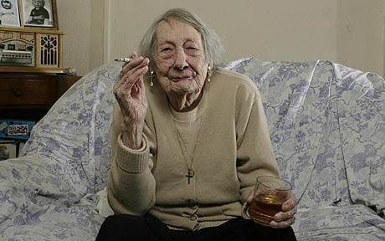
Principle 3
Mental Capacity Act
“A person is not to be treated as unable to make a decision merely because he/she makes an unwise decision.”
Everybody has their own values, beliefs, preferences and attitudes. A person should not be assumed to lack the capacity to make a decision just because other people think their decision is unwise. This applies even if family members, friends, healthcare or social care staff are unhappy with a decision.

Slide 18
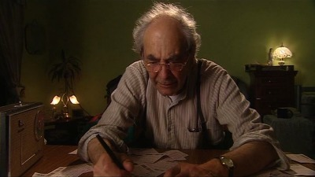
Unwise Decisions
Example: Reginald feels lucky with the lottery this week …
What are the questions you would ask?
Notes:
Follow Principles 1&2.
Tell Me why
Explain to me what
Describe to me how

Slide 19
Case Scenario In re C (Adult: Refusal of Treatment)
Consider the English decision In re C (Adult: Refusal of Treatment). C was a patient at a secure hospital. Doctors diagnosed C with paranoid schizophrenia and found he had a number of delusional beliefs, including a belief that he was a great doctor who had a 100 percent record of restoring injured limbs. Ironically, C suffered an injury to his foot that developed gangrene. His doctors informed him there was an eighty-five percent chance he would die if the foot were not amputated. C understood his diagnosis and prognosis but disagreed with the doctors and refused the treatment; believing that God would heal him of any medical problems.
Taken From – Entering the Fog: On the Borderlines of Mental Capacity, Jonathan Herring, Exeter College, University of Oxford

Slide 20
Case Scenario In re C (Adult: Refusal of Treatment)
The court found C to be competent and to possess mental capacity. The court reasoned that C understood the doctors' prognosis, but that he disagreed with them. His disagreement did not render him incompetent. C was able to comprehend and retain the information that his doctors told him, and to reach a decision based on that information. The fact that many would find his decision bizarre or irrational does not mean that he should have been judged incompetent.

Slide 21
Principle 4
Mental Capacity Act
Best interests
One of the key principles of the Act is that “any act done for, or any decision made on behalf of a person who lacks capacity must be done, or made, in that person’s best interests.” That is the same whether the person making the decision or acting is a family carer, a paid care worker, an attorney, a court-appointed deputy, or a healthcare professional, and whether the decision is a minor issue – like what to wear – or a major issue, like whether to provide particular healthcare. More about this later…
Notes:
A best interest decision can only be achieved by knowing the person your making the decision for.

Slide 22
Principle 5
Mental Capacity Act
Less Restrictive
Where there is more than one option, it is important to explore ways that would be less restrictive or allow the most freedom for a person who lacks capacity to make the decision in question.
However, the final decision must always allow the original purpose of the decision or act to be achieved.

Slide 23
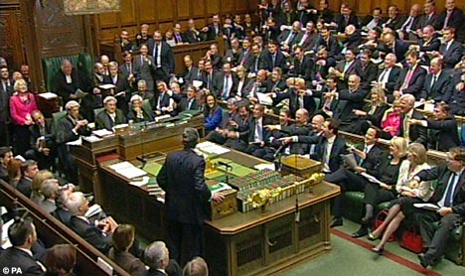
So how do we assess capacity?
(Page 9)

Slide 24
The 2 Stage Assessment of Capacity
For all assessments of capacity or as we will call it ‘supported decision making’ you will use a two stage assessment.
Anyone assessing someone’s capacity to make a decision for themselves needs to assess …

Slide 25

Stage 1 Part 1
Anyone assessing someone’s capacity to make a decision for themselves should use the two-stage test of capacity.
Does the person have an impairment of the mind or brain, or is there some sort of disturbance affecting the way their mind or brain works? (It doesn’t matter whether the impairment or disturbance is temporary or permanent.)
Question: What examples can you think of?

Slide 26
MCA Assessment : Stage 1
Examples of an impairment or disturbance in the functioning of the mind or brain may include the following:
conditions associated with some forms of mental illness
dementia
significant learning disabilities
the long-term effects of brain damage
physical or medical conditions that cause confusion, drowsiness or loss of consciousness
delirium
concussion following a head injury, and
the symptoms of alcohol or drug use.
(MCA Code of Practice, Section 4)

Slide 27
The 2 Stage Assessment of Capacity
Stage 1: (diagnostic test):
Does the person have an impairment of or a disturbance in the functioning of the mind or brain?
If so, does it cause an inability to…
Stage 2: (functional assessment):
Understand the relevant information
Retain the relevant information
Use or weigh the relevant information
Communicate the decision
You must provide Information
including ‘reasonably
foreseeable consequences’
Remember Principle 1-3
Notes:
27
Go through process

Slide 28
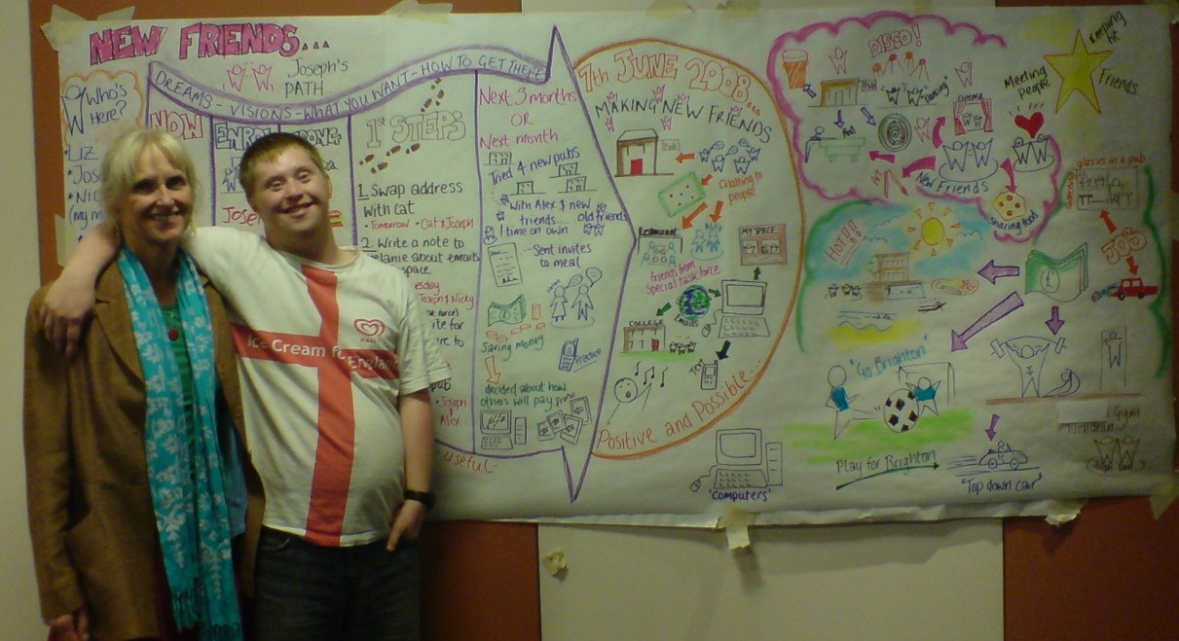

Slide 29


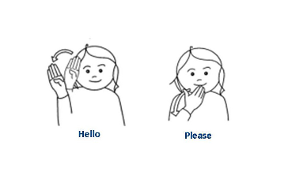

Understanding & Retaining
What ways can you make information easier to understand and retain?
It is normal for people not to remember information correctly
It is normal for people’s memories to be selective
Not a memory test and memory can be assisted

Slide 30

Use & Weighing of
Information (Pg. 10)
4.21 For someone to have capacity, they must have the ability to weigh up information and use it to arrive at a decision. Sometimes people can understand information, but an impairment or disturbance stops them using it. In other cases, the impairment or disturbance leads to a person making a specific decision without understanding or using the information they have been given.
4.22 For example, a person with the eating disorder anorexia nervosa may understand information about the consequences of not eating. But their compulsion not to eat might be too strong for them to ignore.
Some people who have brain damage might make impulsive decisions regardless of information they have been given or their understanding of it.
MCA Code of Practice Chapter 4
3 This issue has been considered in a number of court cases, including Re MB [1997] 2 FLR 426; R v Collins and Ashworth Hospital Authority ex parte Brady [2001] 58 BMLR 173

Slide 31
Communication
Exercise (pg 11): Story telling.
In your pairs decide who will be the story teller and who will be the listener.
Story-teller Take a minute to think of a story about your childhood. You are going to tell this story to your partner. However, you cannot use any words. You may use gestures or pictures. Think about how you are going to do this. What are the important events in your story? Who else does it involve? What emotions would you need to convey?
Listener You are going to be told a story about the story-tellers childhood. However the story-teller cannot use any words. The story can only be told in gestures, pictures, sounds, mime…

Slide 32
Section 5 MCA
The Mental Capacity Act says (in section 5)
That If we do an act connected to a person’s care or treatment and
  We can show that the person lacks capacity to consent to the action we want to carry out, and
  We can show that it is in the person’s best interests that we carry out the action.
Then we do not incur any liability that we wouldn’t have incurred
if the person had capacity to consent and had consented.
In other words as long as we can show why we think the person is unable to consent and also that what we are doing is in the person’s best interests, then we are acting within the confines of the Mental Capacity Act

Slide 33
Supported Decision Making
Remember the 2nd principle:
A person is not to be treated as unable to make a decision unless all practicable steps to help to do so have been taken without success
If we add this to the ‘capacity test’ it means that we have to take all practicable steps to help the person ‘understand, retain, use or weigh and communicate’
Go to page 12
Complete Exercise Mr Craven
For examples of recording look to page 13

Slide 34
Planning for the Future (Pg.14)?
“Next of kin” is not recognised in law”
No adult can consent on behalf of another adult unless with specific legal authority:
  Enduring Powers of Attorney: Property and Affairs (valid if created before launch of MCA)
  Lasting Powers of Attorney: Property and Affairs
  Lasting Powers of Attorney: Personal Welfare
  Deputy appointed by the Court – Office of the Public Guardian
  Appointee – Department for Work and Pensions
  Other ways of planning for a time when you may be unable to make a decision
  Advanced decisions (Legal)
  Advanced Directives / Living Wills (Not Legal)
Notes:
READ SLIDE

Slide 35
Best Interests Checklist
Will the person have capacity in the future to make this decision? Can the decision wait?
Don’t make a decision just based on the person’s age, condition, disability etc. We are making a decision about this person and not this type of person
If the decision is about whether or not to give treatment that will keep the person alive, we must not be motivated by the desire to bring about the death of the person.
How can the person still be involved in the decision? Is it in their best interests to do what they want to do?
What do we know about the person’s past and present wishes about the decision? Has the person written anything down?
What do we know about the person’s beliefs and values? What would the person have thought about if they were making the decision?
What can other people tell us about the person’s wishes, feelings, beliefs and values, especially those caring or concerned for the person

Slide 36
Independent Mental Capacity Advocates (Pg. 19)
Independent Mental Capacity Advocate (IMCA) Service
Does the decision relate to: Serious medical treatment OR Long term accommodation change OR Safeguarding Adults Process OR A Care Review AND Does the person Lack capacity AND Have no one else appropriate to consult (see IMCA guidance) If the answer is YES to both parts a referral MUST be made to the IMCA service. Referral to be made to IMCA service? YES NO
Notes:
36

Slide 37
Do you use restraint in your service?
What is the difference between restriction and restraint?
?

Slide 38

Restraint and the MCA
In groups list 10 restraints and restrictions that are used in health and social care settings?
How and when can these be justified in law?

Slide 39
Page 20 of your books
Restraint:
  Use or threat of force when a person resists
  Restricts the person’s liberty of movement, whether or not they resist
Code of Practice 6.40 – 6.53
Notes:
The Act allows you to legally carry out caring actions provided that you have assessed they are in the best interests of the person who lacks capacity. For example, going into someone’s home without their permission to clean if for them or helping the person you care for to bath or dress.
However, where there are several different effective options available to you or a professional who is providing care or treatment, the Act says that you should use the one which is less restrictive.
Sometimes it is necessary to physically restrain a person. The Act allows this but only if it is necessary to prevent the person coming to harm. For example, you may prevent the person you are caring for from stepping out into the middle of a busy road, if that person lacks capacity to understand the danger posed by traffic.
However, any restraint has to be reasonable and in proportion to the potential harm. You might prevent a person from going out alone because they cannot cross roads safely but it would be unreasonable for you to completely stop them from going outdoors to protect them from road traffic as this could amount to a deprivation of their liberty which is not permitted under the Mental Capacity Act.
DO YOU HAVE A GOOD EXAMPLE

Slide 40
Restraint
6.41 Any action intended to restrain a person who lacks capacity will not attract protection from liability unless the following two conditions are met:
the person taking action must reasonably believe that restraint is necessary to prevent harm to the person who lacks capacity, and
the amount or type of restraint used and the amount of time it lasts must be a proportionate response to the likelihood and seriousness of harm.

Slide 41
Restraint and Care Plans
… It became clear that the level of physical restraint being used by carers in Y House was greater than acknowledged in the care plan (and indeed, even in an amended care plan).
As Baker J noted:
“25. In supplemental submissions, Ms Butler-Cole on behalf of the Official Solicitor submitted that in any case in which physical restraint is used in the care of an incapacitated adult, any physical intervention, whether considered to amount to “restraint” or not, should be recorded in the care plan maintained by the service provider and monitored by the statutory body responsible for commissioning the person’s care. Furthermore, precise details of all physical interventions should be ascertained and documented as part of the Deprivation of Liberty Safeguards process or indeed any best interest assessment from direct discussion with care staff implementing the interventions.
AJ, 2015
Notes:
The Act allows you to legally carry out caring actions provided that you have assessed they are in the best interests of the person who lacks capacity. For example, going into someone’s home without their permission to clean if for them or helping the person you care for to bath or dress.
However, where there are several different effective options available to you or a professional who is providing care or treatment, the Act says that you should use the one which is less restrictive.
Sometimes it is necessary to physically restrain a person. The Act allows this but only if it is necessary to prevent the person coming to harm. For example, you may prevent the person you are caring for from stepping out into the middle of a busy road, if that person lacks capacity to understand the danger posed by traffic.
However, any restraint has to be reasonable and in proportion to the potential harm. You might prevent a person from going out alone because they cannot cross roads safely but it would be unreasonable for you to completely stop them from going outdoors to protect them from road traffic as this could amount to a deprivation of their liberty which is not permitted under the Mental Capacity Act.
DO YOU HAVE A GOOD EXAMPLE

Slide 42
The greater the incidence of restrictions and restraints
The greater the erosion of autonomy for the service user
In essence:

Slide 43

MCA & DOLS
Both Mental Capacity Act & Deprivation of Liberty Safeguards come with a Code of Practice

Slide 44
A Deprivation of Liberty has 3 elements:
Objective element:
  Is there a deprivation..? : This part has 2 questions which are, is the person:
  not free to leave?
  under continuous/complete supervision and control?
Subjective element:
  does the person lack capacity [i.e the person cannot consent (because they do not have the capacity to do so) to that confinement]?
Imputable to the state:
  are the arrangements made by a ‘public body’?
Deprivation of Liberty (Page 25)

Slide 45
MCA Principles
Assume capacity…
Provide all practicable help
Respect decision (unwise ≠ incapacity)
Take best interests decisions
Take less restrictive option

Slide 46
Thank you for your time. Further questions can be directed to:
phil.carter@cambridgeshire.gov.uk
07795 302092
or:
james.codling@cambridgeshire.gov.uk
07584 490240
DoLS Office: 01223 715 581

